Slide 1
Practical Task 1: Analyzing Student Feedback Using Artificial Intelligence techniques in Python

Slide 2
Lda
LDA is designed to extract topics from a corpus of text data.
We have set ‘num_topics=5’ to make the LDA model identify 5 topics in the text data.
We have used Gensim dictionary mapping word IDs to words.
The output of the code is a list of topics, each represented by a set of words. These words are the most representative words for each topic.

Slide 3
Lda Analysis
Topic 0: Expressing Gratitude and Positivity
Keywords: شكرا (thank you), great, course, المادة (the material), na, dr, ممتاز (excellent), الدكتور (the doctor), everything, best
This topic seems to revolve around expressions of gratitude and positivity. Participants are likely thanking someone (possibly an instructor) for the course content and might be describing it as excellent or great. "Everything" and "best" indicate high satisfaction.

Slide 4
Lda Analysis
Topic 1: Comments on Course Availability and Quality
Keywords: none, يوجد (there is), amazing, course, suggestions, perfect, nothing, افضل (best), دكتور (doctor), شكرا (thank you)
This topic appears to be a mix of comments related to course availability, quality, and satisfaction. Participants are mentioning the availability of courses, some using positive descriptors like "amazing" and "best," while others might have suggestions or comments on aspects like course quality.

Slide 5
Lda Analysis
Topic 2: Positive Feedback on Instructors and Students
Keywords: course, dr, best, students, doctor, amazing, instructor, us, comment, الدكتور (the doctor)
This topic seems to focus on positive feedback regarding instructors and students. Participants might be praising their instructors, referring to them as the best, and possibly highlighting positive interactions among students.

Slide 6
Lda Analysis
Topic 3: Mixed Sentiments with Thanks
Keywords: great, thanks, nothing, everything, dr, course, good, us, المادة (the material), الدكتور (the doctor)
This topic appears to have a mix of sentiments. While "thanks" and "good" suggest positive feedback, the presence of "nothing" and "everything" might indicate varied opinions or experiences with the course and instructor.

Slide 7
Lda Analysis
Topic 4: Comments on Course Quality and Clear Communication
Keywords: good, course, thank, dr, everything, clear, doctor, المساق (the course), students, افضل (best)
This topic seems to center around comments on course quality, clear communication, and possibly the quality of instructors. Participants might be praising the course content and the instructors' ability to communicate effectively.

Slide 8
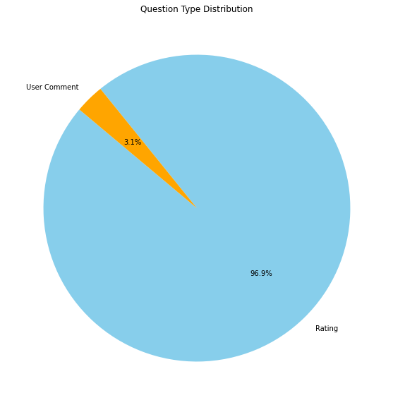
Pie Chart
From the pie chart it is evident that 96.9% of the students have opted for Rating as the Question Type.
Only 3.1% of the students have commented.

Slide 9
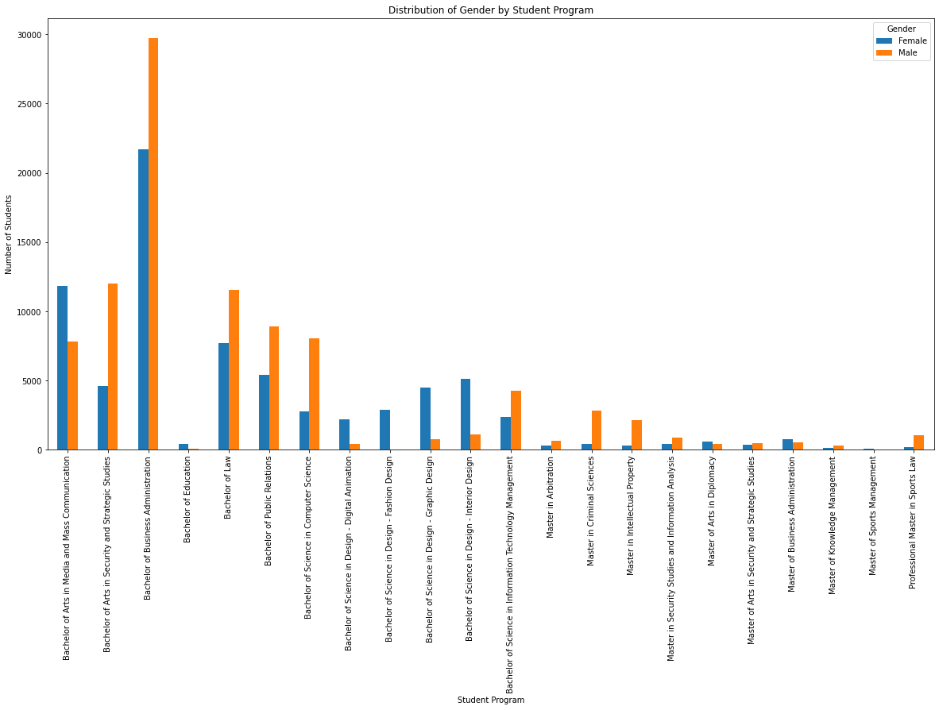
Bar graph
From the bar graph, it is evident that majority of the male and female students have chosen Bachelor of Business Administration.
The least popular course is Master of Sports Management.

Slide 10
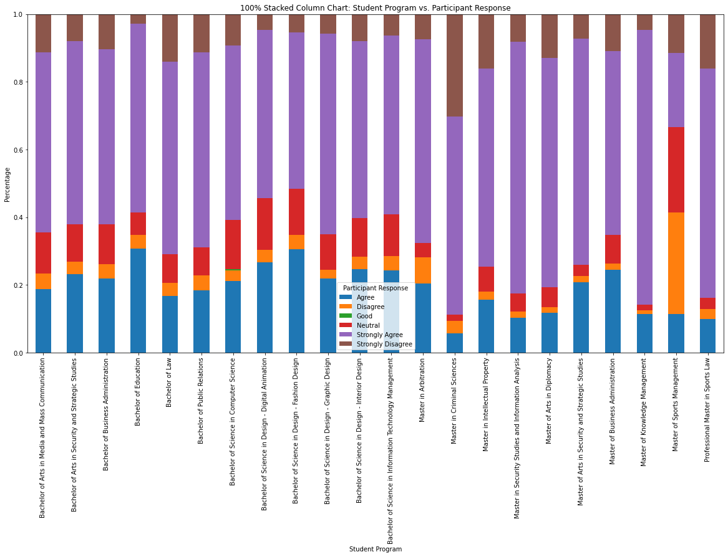
100% stacked Bar graph
From the stacked bar graph, we can see that Master of Criminal Sciences have higher disagreement responses compared to other courses.
Bachlor of Law has high agreement responses.

Slide 11
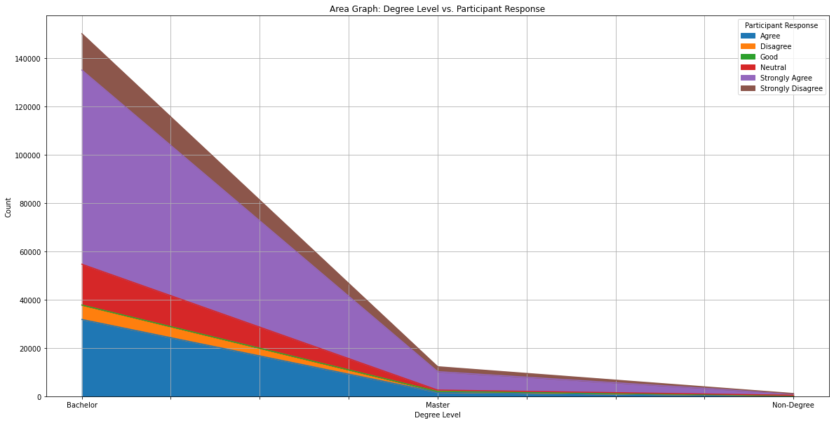
Area graph
From the Area Graph, we can clearly observe that majority of the responses have been recorded from the Bachelors degree level.

Slide 12
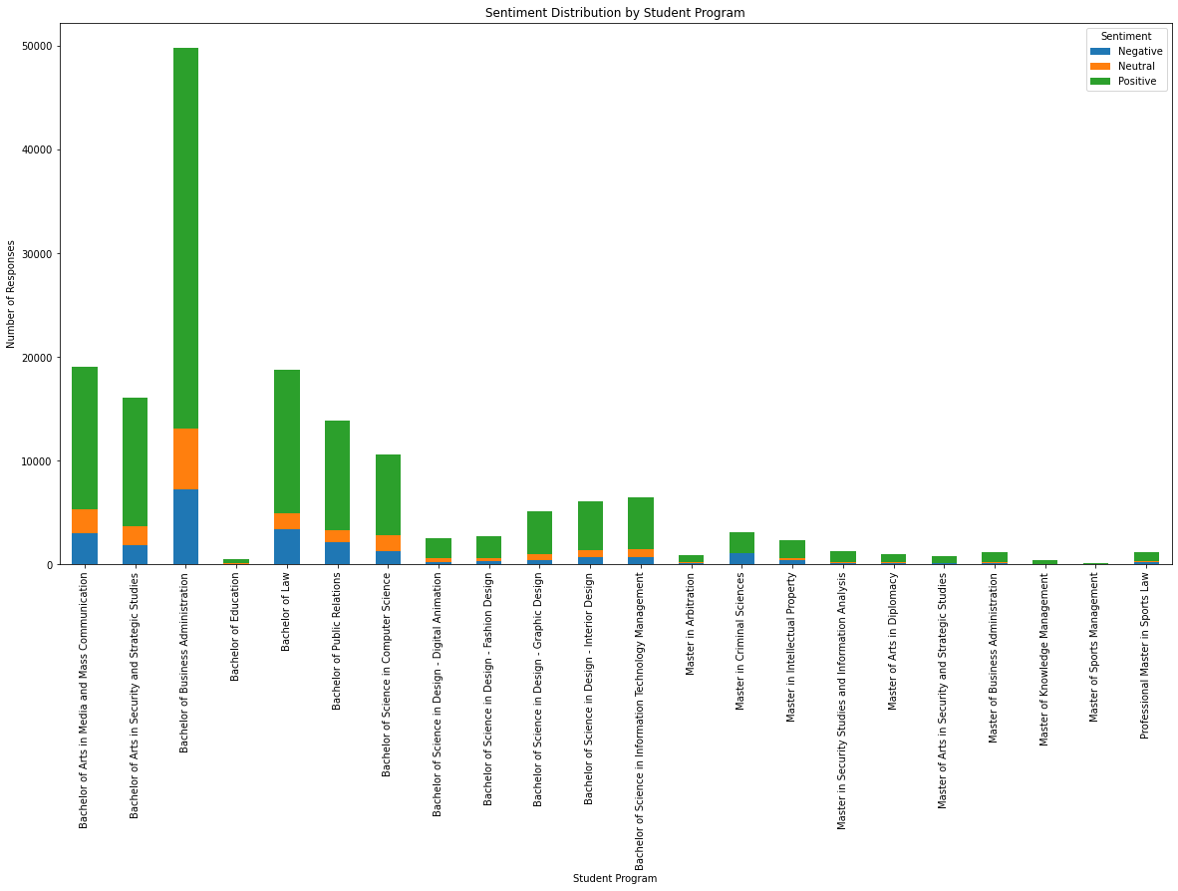
Stack bar graph
From the Stack Bar Graph between student program and sentiments, we can observe that majority of the courses have higher positive sentiments compared to negative sentiments.

